Slide 1
Greedy Operator Ordering
On the 11.11.2019
By Simon Stolz

Slide 2
Structure
Basic GOO approach
ERM generalization
  Cost function
  Switch-HJ and Switch-Idx
  Push
  Pull
Performance
Prospect

Slide 3
Basic GOO
Motivation:
  Optimal approaches can be exponential
  Commercial queries increase in size (50-100)
  Avoid the worst solutions
  Find tree with lowest cost

Slide 4
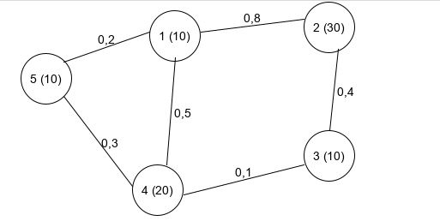
How does it work?
Take combination for which |P1| x |P2| x predicate is the smallest

Slide 5
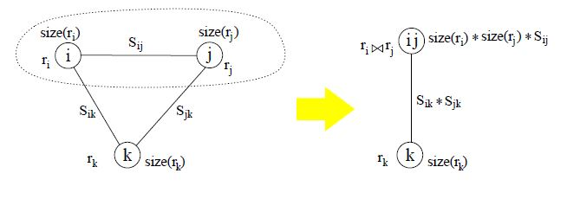
Simple Goo Merge
From „A Heuristic for Optimizing Large Querys“ by Leonidas Fegaras

Slide 6
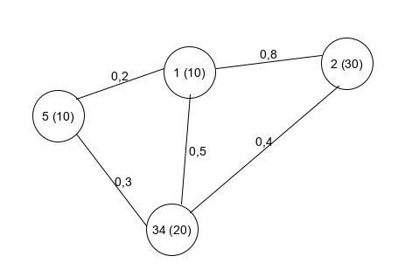
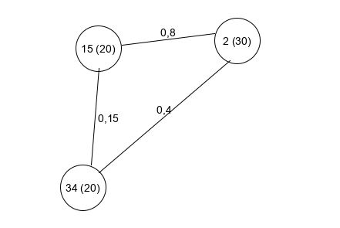
Example

Slide 7
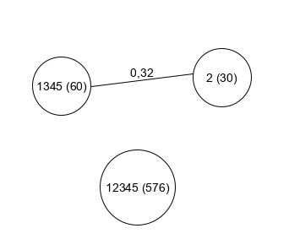
Example

Slide 8
Enumerate Rank Merge
Splitting in 3 semantic parts
O(N^2R+NM)
Extension of basic GOO
Further adaptability

Slide 9
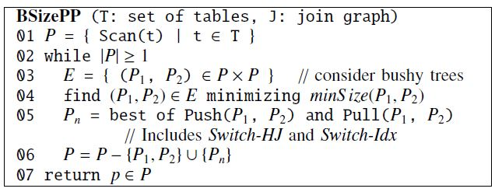
Enumerate Rank Merge
From „How Good Are Query Optimizers, Really?“ by Leonidas Fegaras

Slide 10
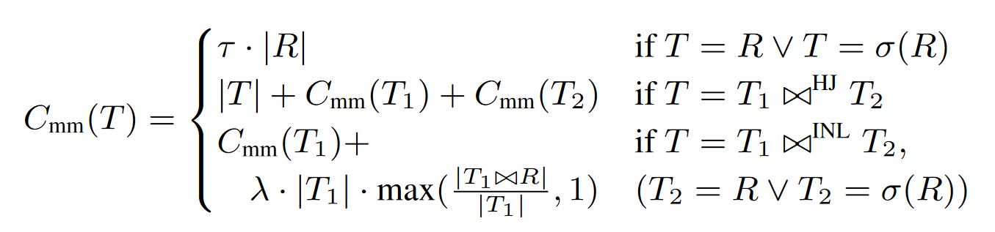
Cost Function
Instead of Cardinalities we use a real cost function
From „How Good Are Query Optimizers, Really?“ by Victor Leis, Andrey Gubichev, Atanas Mirchev Peter Boncz, Alfons Kemper and Thomas Neumann

Slide 11
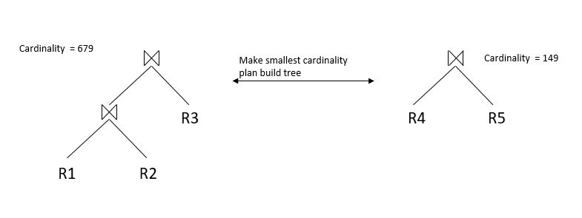
Switch-HJ
Advantageous if applied to reality

Slide 12
Switch-IDx
When the INL case is the cheapest option we swap accordingly, if needed
From „How Good Are Query Optimizers, Really?“ by Victor Leis, Andrey Gubichev, Atanas Mirchev Peter Boncz, Alfons Kemper and Thomas Neumann

Slide 13
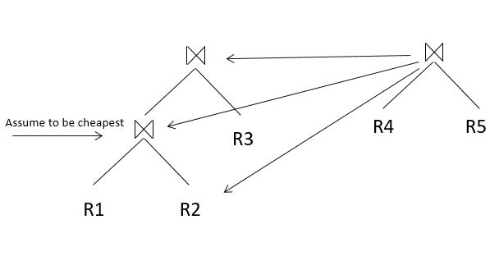
ERM: Push
Assume we have only one join-predicate between R4 and R2

Slide 14
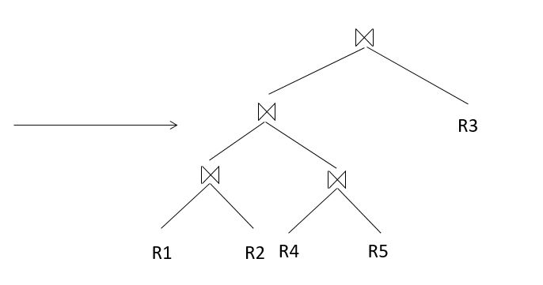
ERM: Push
Pushing the right Plan onto the the sub-tree of the left Plan, that results in the lowest root cost

Slide 15
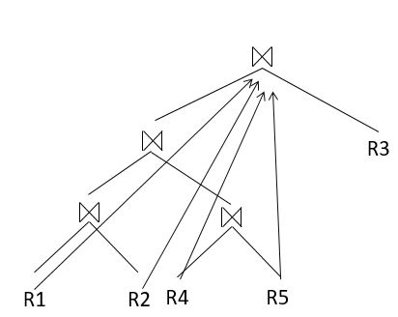
ERM: Pull
We enumerate and rank pulling every table that is not already the right side of a index-join

Slide 16
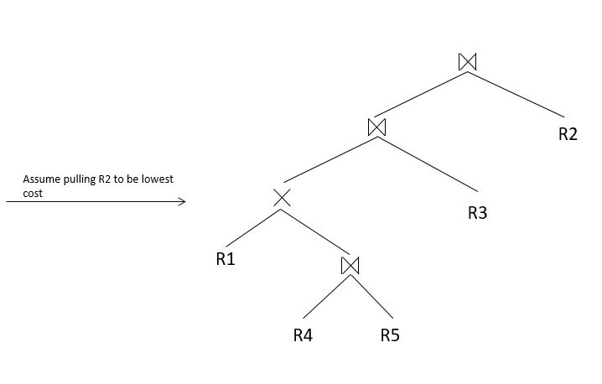
ERM: Pull
Push and Pull correct early mistakes

Slide 17
Quality of Plans
Goo does not find the optimal Plan
Percentage increase in cost compared to DP algorithm:
  0,0% for 5 tables
  0,15% for 10 tables
  72,86% for 15 tables
  0,35% for 20 tables

Slide 18
Prospect
Group-by clauses
Semi-join operators
Anti- and Outer-joins

Slide 19
Sources
“How Good Are Query Optimizers, Really?“ by Victor Leis, Andrey Gubichev, Atanas Mirchev Peter Boncz, Alfons Kemper and Thomas Neumann
“A new heuristic for optimizing large queries.” by Leonidas Fegaras
“Polynomial heuristics for query optimization” by Nicolas Bruno, César A. Galindo-Legaria and , and Milind Joshi

Slide 20
Thanks for listening!

Slide 21
Optional Slides
Following slides will only be used if they are usefull for asked question

Slide 22
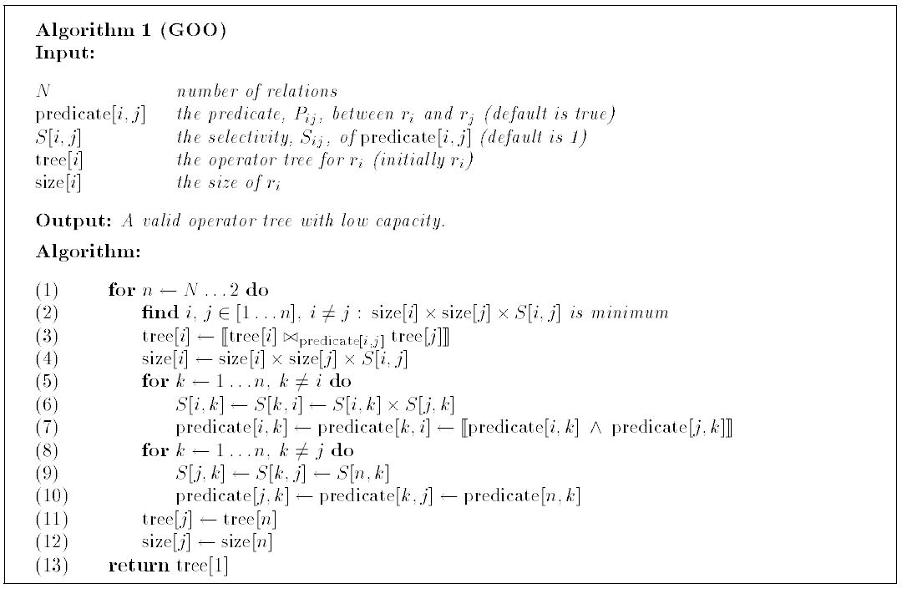
Basic GOO
From „A Heuristic for Optimizing Large Querys“ by Leonidas Fegaras

Slide 23
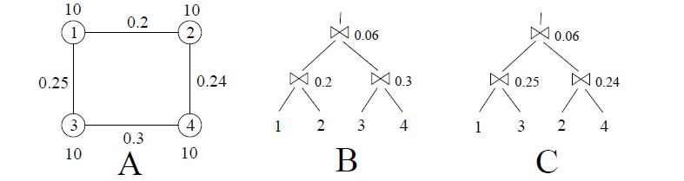
Basic Goo not Optimal
From „A Heuristic for Optimizing Large Querys“ by Leonidas Fegaras
B: 20+30+36=86 C: 25+24+36 = 85

